Slide 1
Introduction to Arduino Prototyping Platform
Rahul Shrivastava

Slide 2
Overview
Background
Microcontroller defined/Why Arduino's?
Types of Arduino
What To Get (Hardware and Software)
Arduino C
Electronic Circuits
Projects
Blinking light(s)
Reading inputs (variable resistors)

Slide 3
Microcontrollers – One Definition
Programmers work in the virtual world.
Machinery works in the physical world.
How does one connect the virtual world to the physical world?
Enter the microcontroller.
A microcontroller is basically a small-scale computer with generalized (and programmable) inputs and outputs.
The inputs and outputs can be manipulated by and can manipulate the physical world.

Slide 4
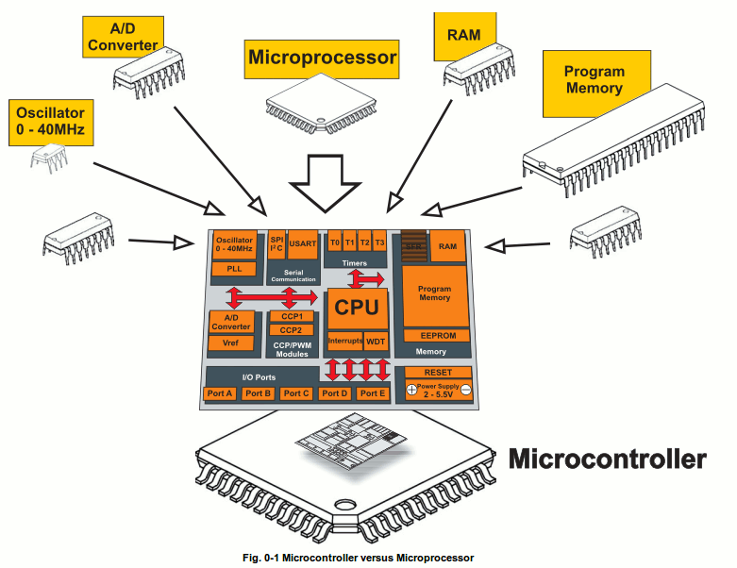
What is a Microcontroller
A small computer on a single chip
containing a processor, memory, and input/output
Typically "embedded" inside some device that they control
A microcontroller is often small and low cost

Slide 5
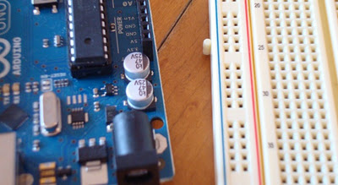
What is a Development Board
A printed circuit board designed to facilitate work with a particular microcontroller.
Typical components include:
power circuit
programming interface
basic input; usually buttons and LEDs
I/O pins

Slide 6
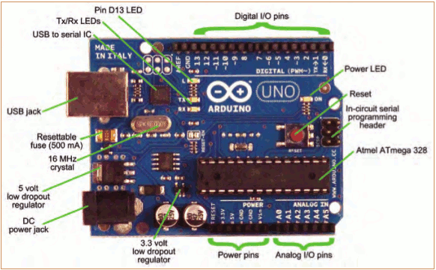
The Arduino Development Board

Slide 7
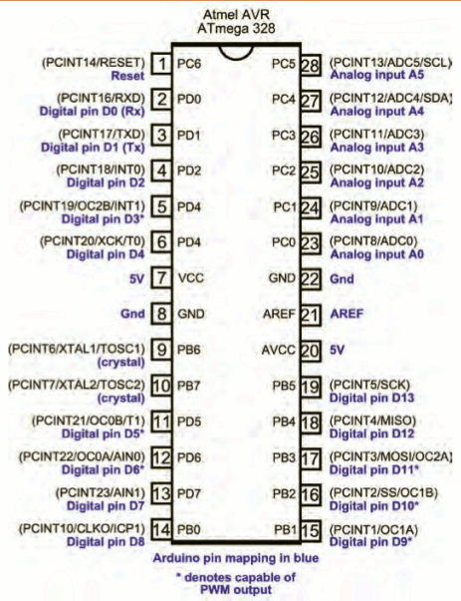
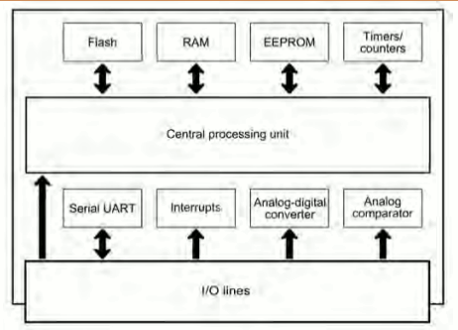
The Arduino Microcontroller: Atmel ARV Atmega 328

Slide 8
Arduino – Official Definition
Taken from the official web site (arduino.cc):
Arduino is an open-source electronics prototyping platform based on flexible, easy-to-use hardware and software. It's intended for artists, designers, hobbyists, and anyone interested in creating interactive objects or environments.

Slide 9
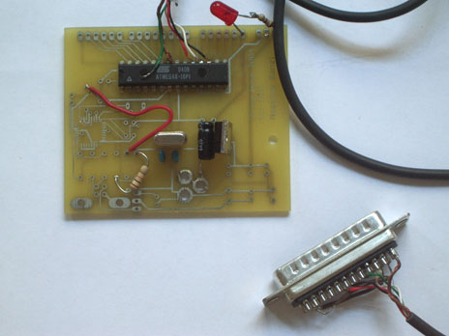
Arduino…
is the go-to gear for artists, hobbyists, students, and anyone with a gadgetry dream. rose out of another formidable challenge: how to teach students to create electronics, fast.

Slide 10
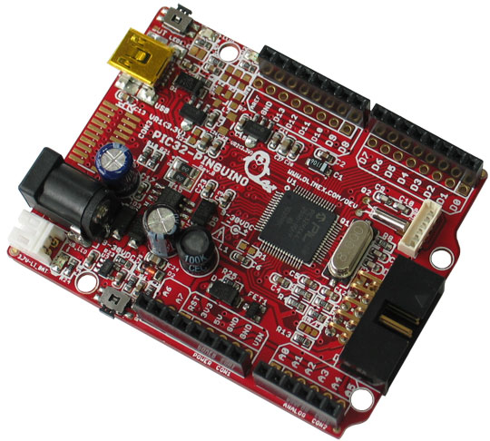
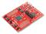
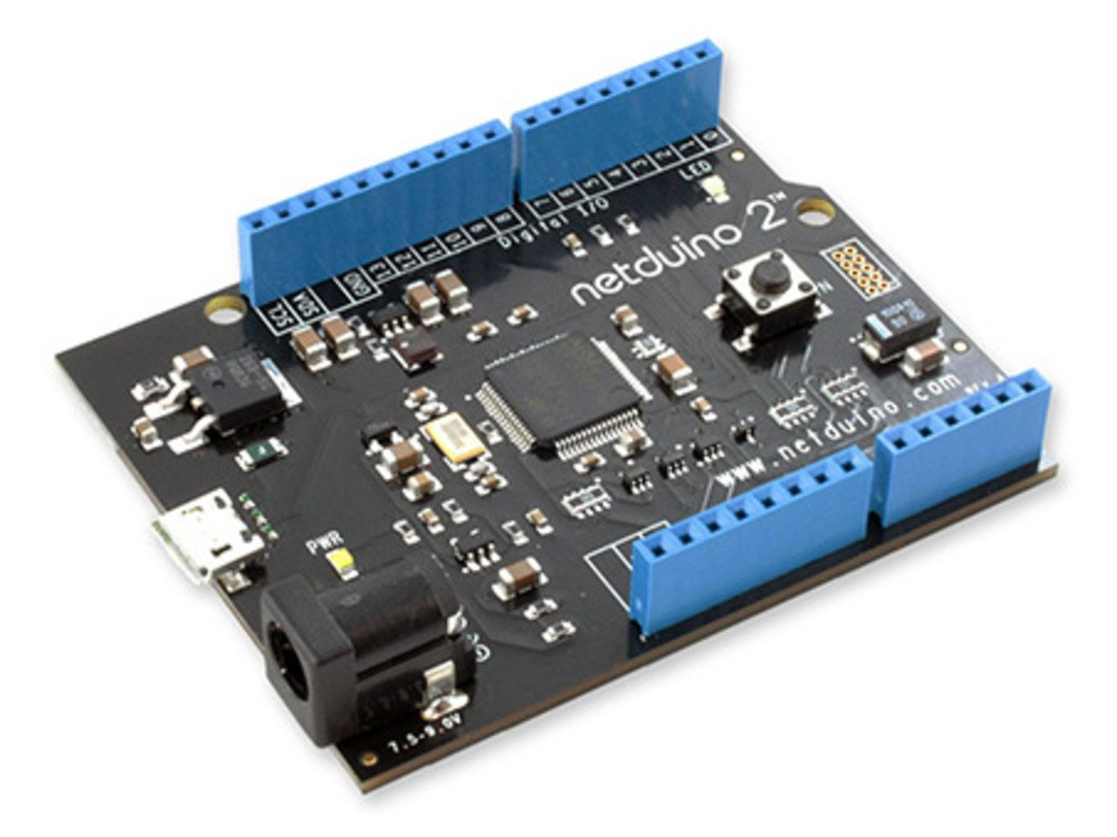
“Competitors“ to the Arduino
PIC controller
Microcontroller programmed with C or assembler
Alternatives to the Arduino line
Pinguino – PIC controller
MSP430 – Texas Instruments; $4.30
Others: customs, Teensy, etc.
Netduino
Computers
Raspberry Pi
BeagleBones – TI; has computer and controller

Slide 11
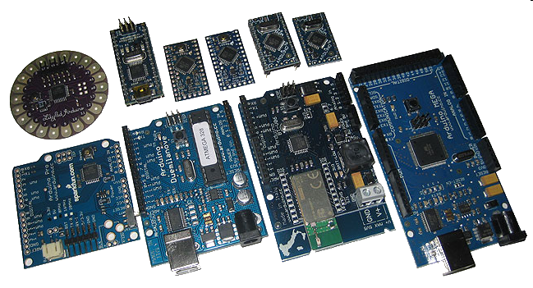
Arduino Types
Many different versions
Number of input/output channels
Form factor
Processor
Leonardo
Due
Micro
LilyPad
Esplora
Uno

Slide 12
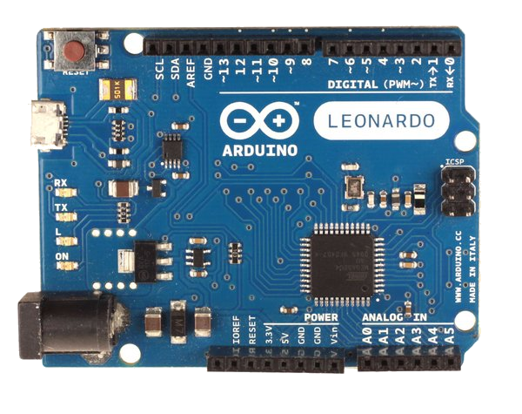
Leonardo
Compared to the Uno, a slight upgrade.
Built in USB compatibility
Presents to PC as a mouse or keyboard

Slide 13
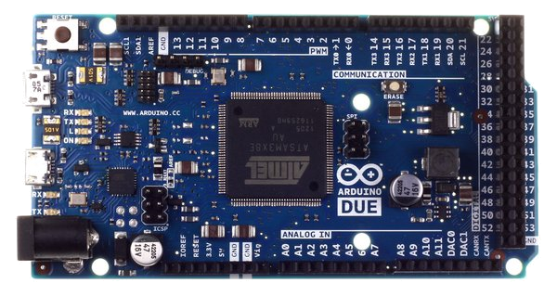
Due
Much faster processor, many more pins
Operates on 3.3 volts
Similar to the Mega

Slide 14
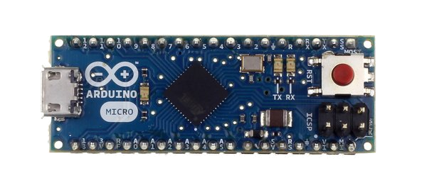
Micro
When size matters: Micro, Nano, Mini
Includes all functionality of the Leonardo
Easily usable on a breadboard

Slide 15
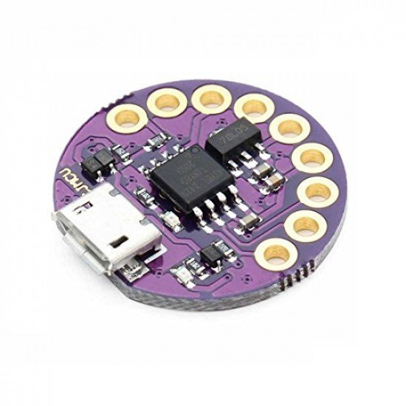
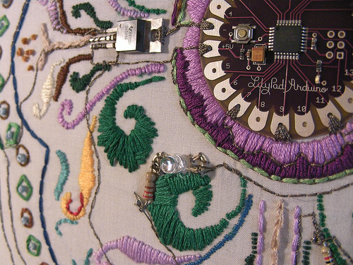
LilyPad
LilyPad is popular for clothing-based projects.

Slide 16
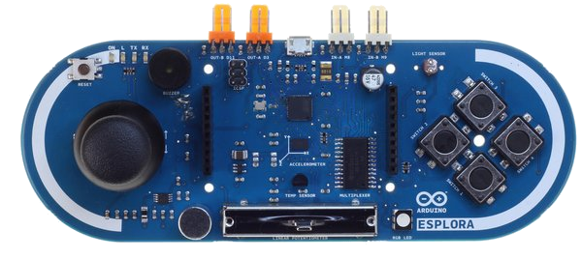
Esplora
Game controller
Includes joystick, four buttons, linear potentiometer (slider), microphone, light sensor, temperature sensor, three-axis accelerometer.
Not the standard set of IO pins.

Slide 17
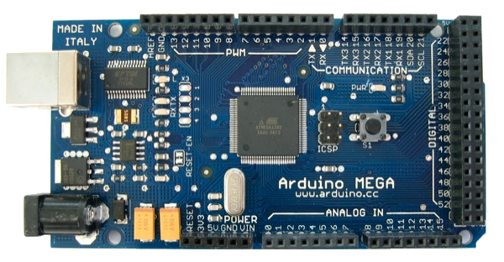
Mega
Compared to the Uno, the Mega:
Many more communication pins
More memory

Slide 18
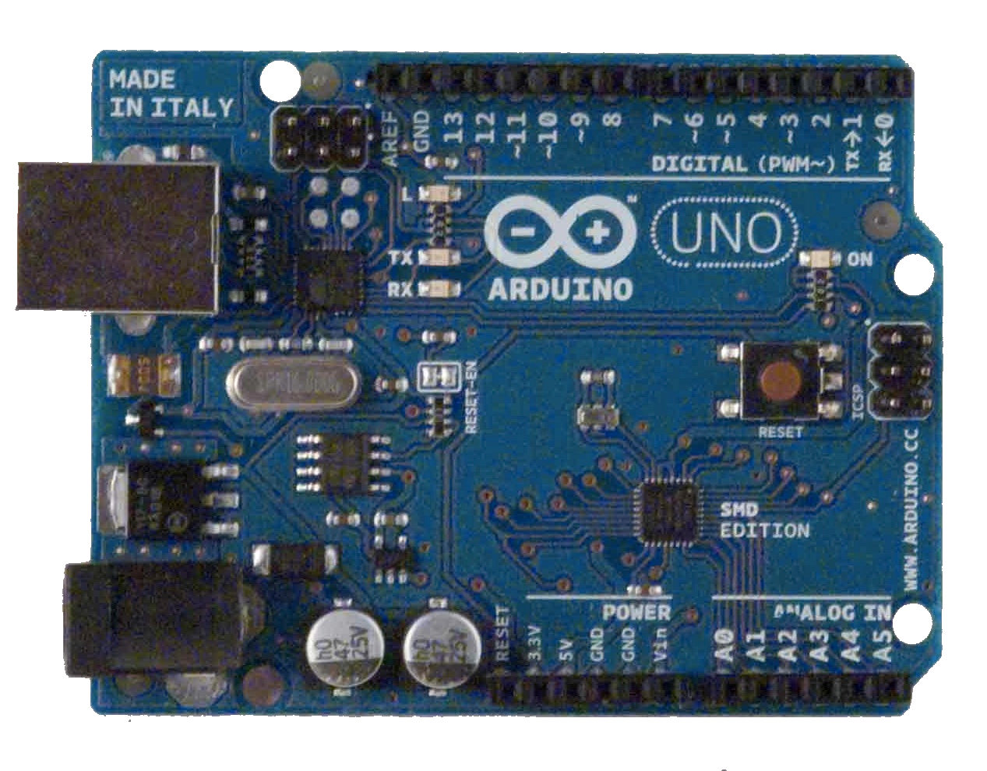
Arduino Uno Close Up
The pins are in three groups:
Invented in 2010
14 digital pins
6 analog pins
power

Slide 19
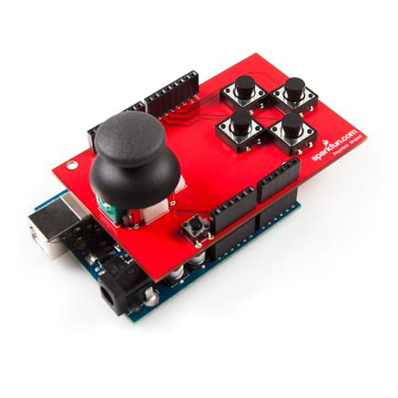
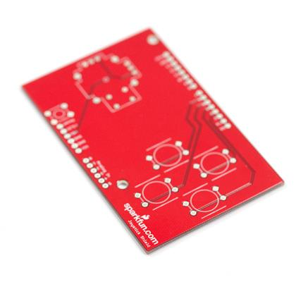
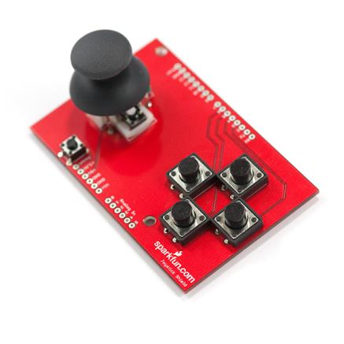
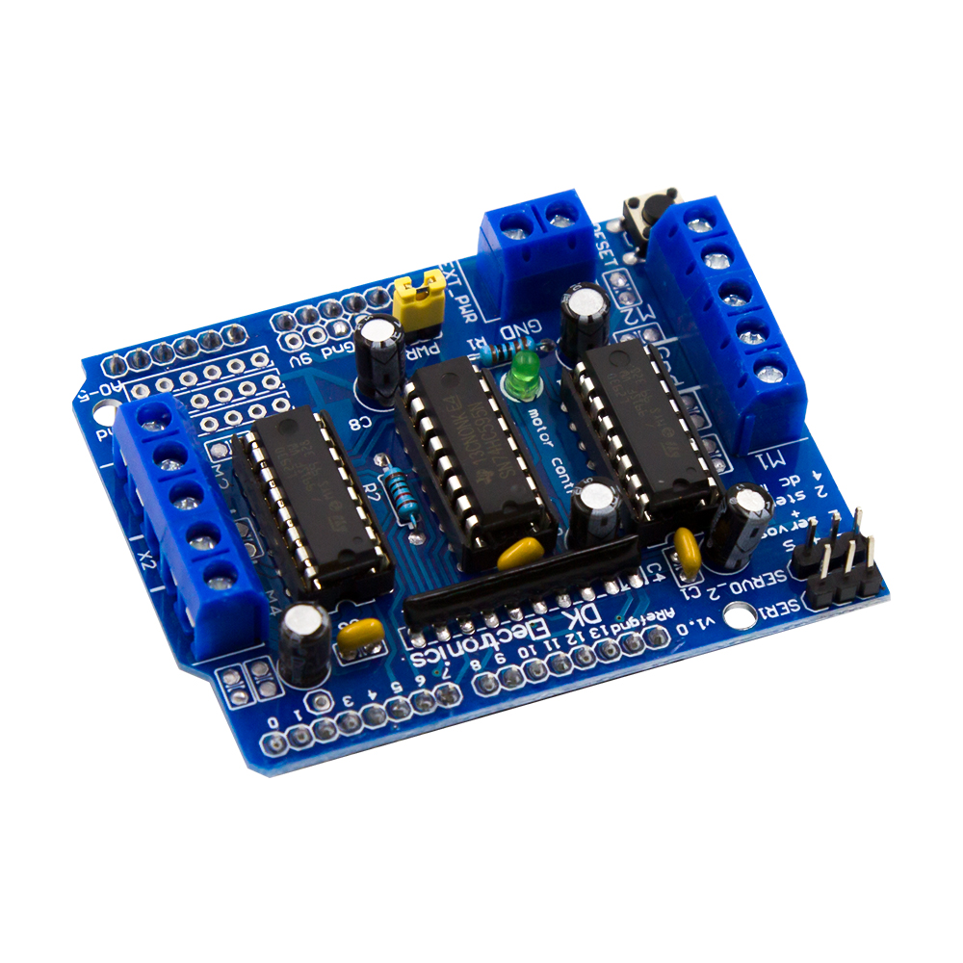
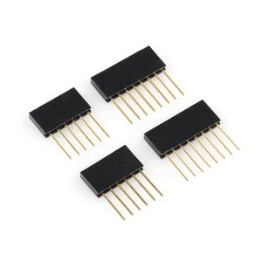
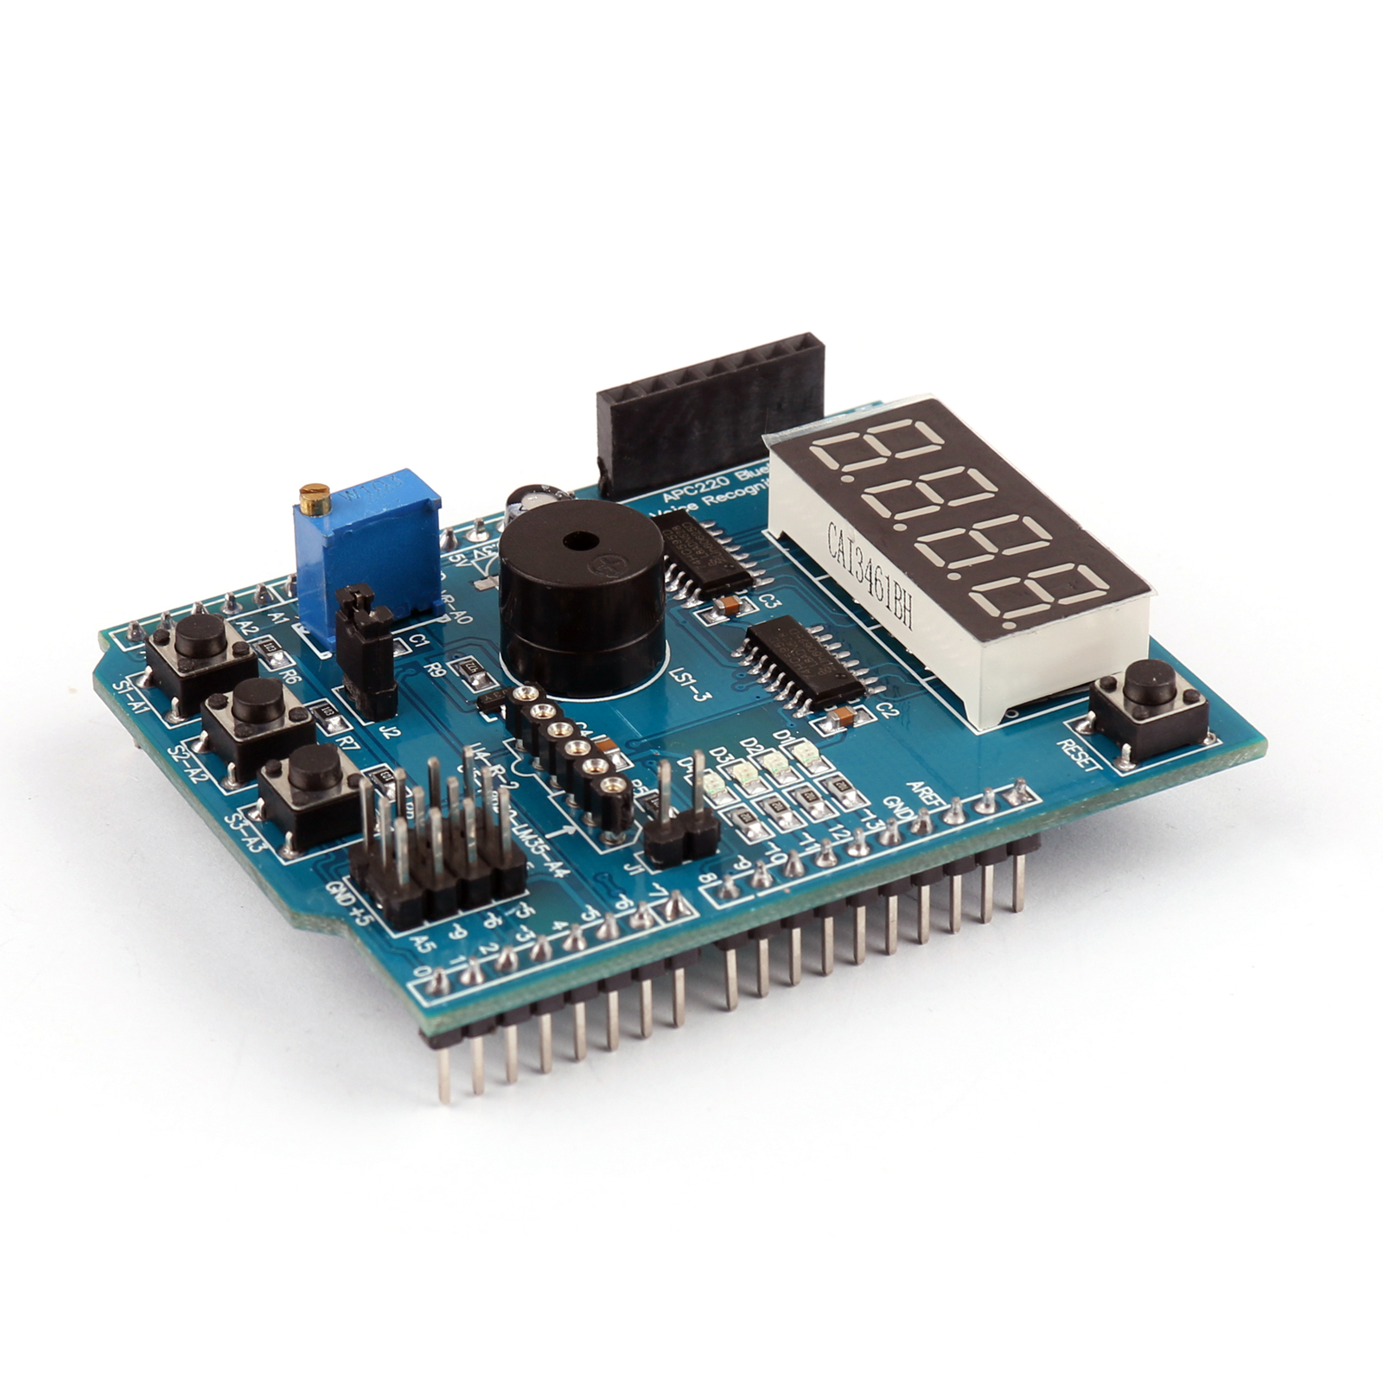
Arduino Shields
PCB
Built Shield
Inserted Shield

Slide 20
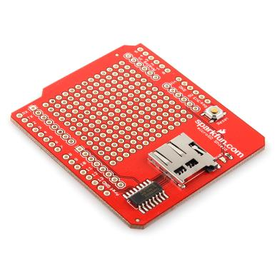
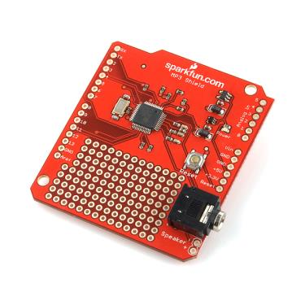
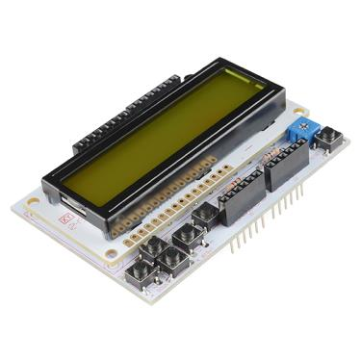
Arduino Shields
Micro SD
MP3 Trigger
LCD

Slide 21
Smart City Street lights control & monitoring
By Rahul Shrivastava

Slide 22
Smart City: Street Lights Control and Monitoring: Introduction
Street lights are one of the main city’s assets which provide safe roads, inviting public areas, and enhanced security in homes, businesses, and city centers
The goal is to automate street lighting, as current system is facing many problems.
A user has to deal with numerous problems like
maintenance problem,
timer problem,
connectivity problem,
display problem.
The solution to these problems is IoT Based Street Lights.

Slide 23
Smart City: Street Lights Control and Monitoring: Issues
Timer Problem-Contractors needs to manage timer settings manually. As timer requires twelve hour of continuous electricity supply, and if in case it is not available, it will delay further timer settings.
Maintenance problem-If any of the streets light gets failed or any problem occurs
Incorrect Readings-Sometimes exact readings are not shown on to the display. So we cannot conclude how much energy is being consumed which give rise in high billing.

Slide 24
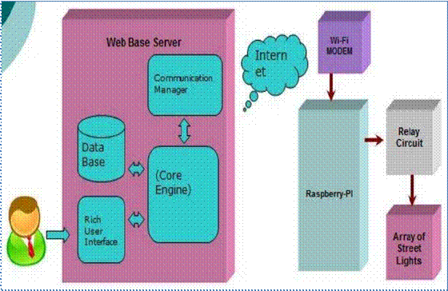
Smart City: Street Lights Control and Monitoring: Components

Slide 25
Smart City: Street Lights Control and Monitoring: Components
Energy efficiency using SSL (smart street light system)
The SSL system, a framework for fast, reliable, and power efficient street lamp switching based on pedestrians’ location and personal desires of safety .
In the developed prototype user location, detection as well as safety zone definition and announcement of other configuration information is accomplished using standard Smartphone capabilities.
An application on the phone is periodically sending location and other information to the SSL server.
For street lamp control, each and every lamppost is extended with a ZigBee-based radio device, receiving control information from the SSL server via multi-hop routing.

Slide 26
Smart City: Street Lights Control and Monitoring: Components
Embedded Platform for IoT applications
For embedded platforms, CoAP (Constraint Application protocol) is used for IOT applications.
The main idea of this protocol is to provide a lightweight protocol for resource-oriented applications run on constrained networks.

Slide 27
Smart City: Street Lights Control and Monitoring: Components
Electrical power saving using VANET
The huge amount of electrical power of many countries is consumed in lighting the streets.
However, vehicles pass with very low rate in specific periods of time and parts of the streets are not occupied by vehicles over time.
An efficient autonomous street lighting control and monitoring system based on the innovative technology named as Vehicular Ad-Hoc Networks (VANET) is proposed.
The system can be integrated with VANET to reduce the cost and use the rich services and communication features of VANET.
Huge energy can be saved without affecting the visibility and the safety of the drivers.
It can extend the lifetime of the lamps. It can automatically monitor the street lighting equipment’s and warn the maintenance traffic authority upon failure detection in any place of the streets.

Slide 28
Smart City: Street Lights Control and Monitoring: Components
System
Raspberry-Pi is used to provide interface between user and system.
This system includes two admin: System admin and Operational admin.
System admin handles log messages and operational admin.
System admin can add, delete and view operational admin.
Once the operational admin added to the system by the system admin then operational admin can log in to the system.
For example, operational admin choose the city and area from database to ON or OFF the street lights.
And if any fault occurs in the functioning of street lights then relay circuit will send the faulty street light’s IP address to the operational admin then operation admin will resolve the problem.

